Slide 1
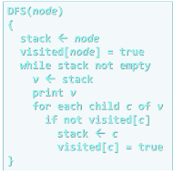
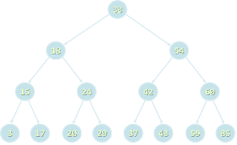

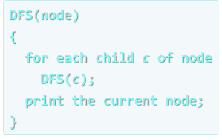


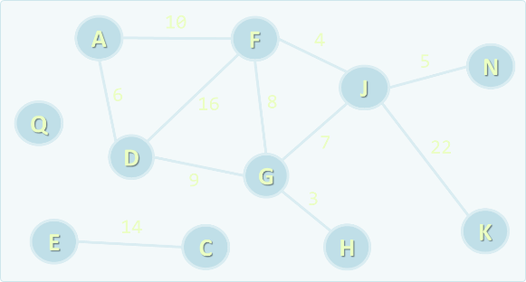
Data Structures
Course Overview
Data
Structures
SoftUni Team
Technical Trainers
Software University
http://softuni.bg

Slide 2

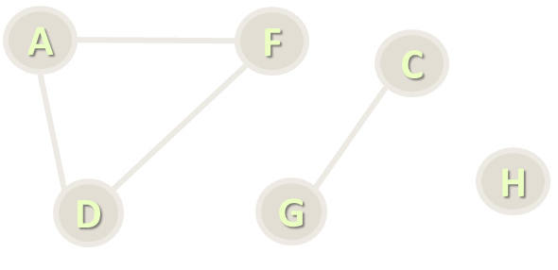
Table of Contents
Course Program
Trainers Team
Examination
Learning Resources

Slide 3

Data Structures
Course Program

Slide 4
Data Structures – Course Program
Course Overview
Linear Data Structures – Lists and DS Complexity
Linear Data Structures – Stacks and Queues
Basic Tree Data Structures – Tree, Binary Tree
Binary Search Trees
Heaps and Priority Queues
B-Trees and Red-Black Trees

Slide 5
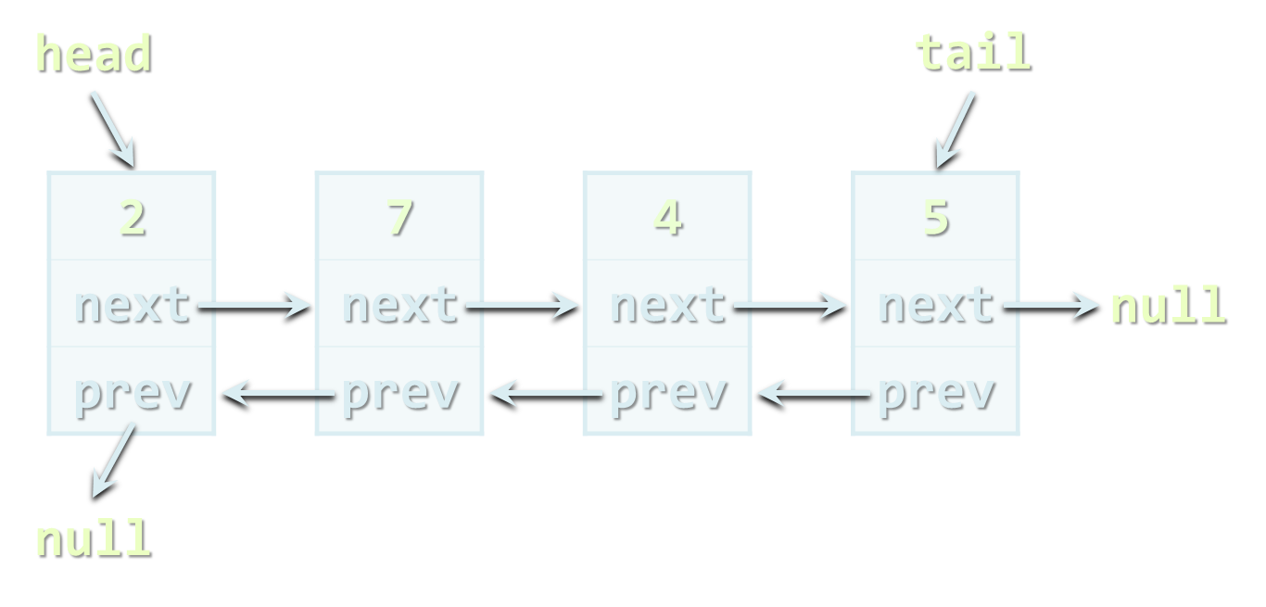
Data Structures – Course Program (2)
AA-Trees and AVL trees
Rope and Trie
Quad Trees, K-d Trees, Interval Trees
Hash Tables, Sets and Dictionaries
Combining Data Structures
Exam Preparations
Practical Exam

Slide 6
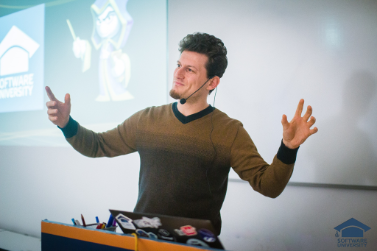
The Trainers Team

Slide 7

Trainers Team
Georgi Angelov
Technical Trainer @ Software University
Top performing student from the Software University
Majoring in Computer Science at University of Telecommunications and Posts, Sofia
Passionate when it comes to programming

Slide 8

Trainers Team
Simeon Sheytanov
Technical Trainer @ Software University
Top performing student from the Software University
Programming experience with C#, Java, C++, Python, JavaScript, PHP, VB, Assembler and other programming languages
Interested in game development

Slide 9

Trainers Team
Peter Penev
Technical Trainer @ Software University
Top performing student from the Software University
Deep interest in Data Structures & Algorithms

Slide 10

Training Duration – Data Structures
Lessons: ~ 25 hours (YouTube videos)
Exercises: ~ 18 hours
Exam preparation: 8 hours
Homework: ~ 30-50 hours
Schedule: December – February 2019
Practical exam: 24 February 2019
Retake exam: 10 March 2019

Slide 11
Programming Languages
The recommended language for this course is C#
Exercises assume you will write in C# + Visual Studio
Labs and examples will also focus on C# and Visual Studio
Homework can be submitted in C# or Java
At the final exam attendees can use:
C# or Java

Slide 12


Scoring System for the "Data Structures"
Practical exam
90%
Labs/Homework
(1 week deadline after exercise)
up to 10% bonus

Slide 13


Data Structures – Practical Exam
2 problems for 6 hours
Data structure + Command execution system
E.g. hierarchy + add + get parent, etc.
E.g. add + edit + remove tickets + search, etc.
Available unit tests to test solution
Automated judge system / real-time feedback

Slide 14









Resources
What We Need Additionally?

Slide 15



Data Structures Web Site, Forum and FB Group
Official web site:
Official discussion forum:
Official Facebook groups:
https://softuni.bg/trainings/2225/data-structures-december-2018-online
https://softuni.bg/forum/categories/32/strukturi-ot-danni-i-algoritmi
https://www.facebook.com/groups/DataStructuresDecember2018Online/

Slide 16

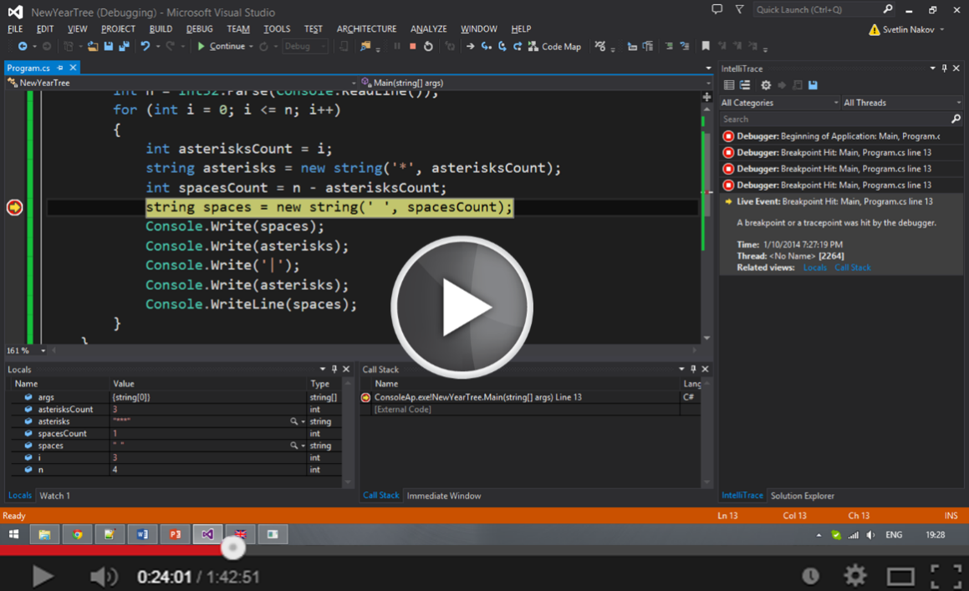

Data Structures Slides and Videos
All lecture slides, videos, homework assignments, labs and other resources are open content, available for free
Visit the course web site to access the course resources

Slide 17

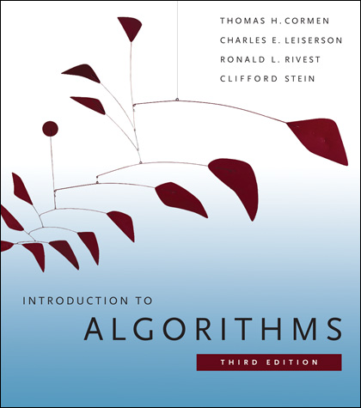
Data Structures – Additional Resources
Nakov P., Dobrikov P., "Programming = ++ Algorithms;", 5th Edition, ISBN: 954-8905-06-X, Faber Publishing (2015)
Download a free copy from: www.programirane.org
No English version (Bulgarian only)
Cormen T., Leiserson C., Rivest R., Stein C., "Introduction to Algorithms", 3rd Edition, ISBN 978-0262033848, MIT Press (2009)
Find the book in Internet: https://goo.gl/ElgQD3

Slide 18
Recommended Software
Visual Studio Community 2017
Or other C# development environment
SharpDevelop – lightweight IDE for C#
Xamarin Studio – powerful IDE for C# / .NET for Linux, Mac OS X, Windows and others
Wintellect Power Collections
https://powercollections.codeplex.com
Eclipse / IntelliJ IDEA (for Java), Code::Blocks (for C++)

Slide 19

Contacts
t.stefanova@sotuni.bg

